Slide 1
Mobile Computing
Mohammad L. Habib
Instructor: Dr. Aggarwal
60-520-02

Slide 2
Presentation Outline
What is mobile computing?
Comparison to wired networks
Why go mobile?
Types of wireless devices
Mobile objects
Moving object databases (MOD)
Query language for MOD
Applications of mobile computing
Challenges
Future of mobile computing
Conclusion

Slide 3

What Is Mobile Computing?
What is computing?
Operation of computers (according to oxfords advance learner’s dictionary)
What is the mobile?
That someone /something can move or be moved easily and quickly from place to place
What is mobile computing?
Users with portable computers still have network connections while they move

Slide 4
What Is Mobile Computing? (Cont.)
Is using a digital camera “Mobile Computing”, or using an MP3 player or handheld computer (e.g. 3Com’s Palm Pilot or Compaq’s iPAQ 3660)?

Slide 5
What Is Mobile Computing? (Cont.)
A simple definition could be:
Mobile Computing is using a computer (of one kind or another) while on the move
Another definition could be:
Mobile Computing is when a (work) process is moved from a normal fixed position to a more dynamic position.
A third definition could be:
Mobile Computing is when a work process is carried out somewhere where it was not previously possible.

Slide 6
What Is Mobile Computing? (Cont.)
Mobile Computing is an umbrella term used to describe technologies that enable people to access network services anyplace, anytime, and anywhere.

Slide 7
Comparison to Wired Net.
Wired Networks
high bandwidth
low bandwidth variability
can listen on wire
high power machines
high resource machines
need physical access(security)
low delay
connected operation
Mobile Networks
low bandwidth
high bandwidth variability
hidden terminal problem
low power machines
low resource machines
need proximity
higher delay
disconnected operation

Slide 8
Why Go Mobile?
Enable anywhere/anytime connectivity
Bring computer communications to areas without pre-existing infrastructure
Enable mobility
Enable new applications
An exciting new research area

Slide 9

Types of Wireless Devices
Laptops
Palmtops
PDAs
Cell phones
Pagers
Sensors

Slide 10

Mobile Objects
A mobile object is some code that carries a state

Slide 11

Mobile Objects (Cont.)
A mobile object is some code that carries a state
that lives on a host

Slide 12
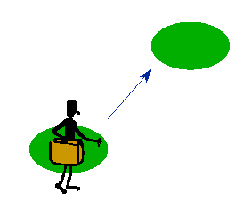
Mobile Objects (Cont.)
A mobile object is some code that carries a state
Lives in a host
That visits places

Slide 13
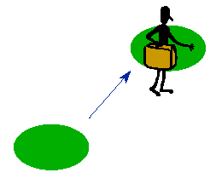
Mobile Objects (Cont.)
A mobile object is some code that carries a state
Lives in a host
That visits places
which is let in when trusted

Slide 14

Mobile Objects (Cont.)
A mobile object is some code that carries a state
Lives in a host
That visits places
which is let in when trusted
and barred when untrusted

Slide 15

Mobile Objects (Cont.)
A mobile object is some code that carries a state
Lives in a host
That visits places
which is let in when trusted
and barred when untrusted
and will refuse to go to untrustworthy places

Slide 16

Mobile Objects (Cont.)
Mobile objects can talk to their friends

Slide 17
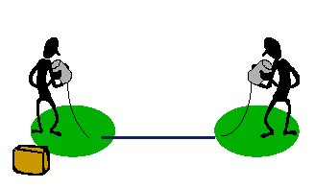
Mobile Objects (Cont.)
Mobile objects can talk to their friends
but only by co-operation of the hosts

Slide 18
Moving Object Databases (MOD)
Deals with Mobile Objects whose geometry, position changes over time
Traditional DBMS alone is incapable for this purpose
MOD is built on top of existing DBMS to support a critical set of capabilities

Slide 19
Moving Object Databases (MOD) (Cont.)
DOMINO (Databases for Moving Objects Tracking) Approach
System Architecture
DOMINO
ArcView GIS
Informix DBMS

Slide 20
Moving Object Databases (MOD) (Cont.)
Omnitracs
developed by Qualcomm
Is a commercial system used by the transportation industry
Provides location management by connecting vehicles, via satellites, to company DB
Vehicles are equipped with GPS, and they they automatically and periodically report their location

Slide 21
Query Language for MOD
Regular query language (SQL) is nontemporal
For MOD we need Spatial and Temporal Query language
“Where is the nearest station?”
“What is the distance of the closest taxicab?”

Slide 22
Query Language for MOD (Cont.)
Some proposed query language:
Future Temporal Logic (FTL)
MobSQL
SQL like query languages with specific predicates and operators to address temporal issues

Slide 23
Query Language for MOD (Cont.)
What is the nearest station?
SELECT station.name, station.address
FROM station in Stations
WHERE NEAREST (HERE,station);
“At what time truck 12A arrive to Windsor ”
SELECT t
FROM v in Trucks, c in Cities
WHERE v WITHIN(t) c and v.id = 12A
and c.name=Windsor

Slide 24
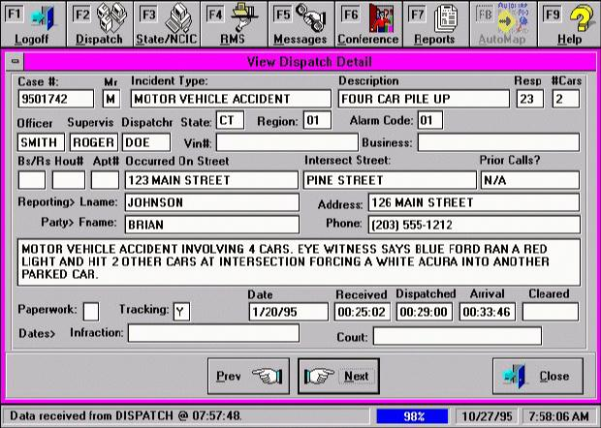
Applications of Mobile Computing
Emergency services

Slide 25
Applications of Mobile Computing (Cont.)
For Estate Agents
In courts
In companies
Stock Information Collection/Control
Credit Card Verification
Taxi/Truck Dispatch
Electronic Mail/Paging

Slide 26
Challenges
Disconnection
Low bandwidth
High bandwidth variability
Low power and resources
Security risks
Wide variety terminals and devices with different capabilities
Device attributes
Fit more functionality into single, smaller device

Slide 27
Future of Mobile Computing
Use of Artificial Intelligence
Integrated Circuitry -> Compact Size
Increases in Computer Processor speeds

Slide 28
Conclusion
Mobile computing has severe limitations
- however, it is far from impossible, and technology improves all the time
Lots of challenges
- some have (good) solutions, many others are still waiting to be solved

Slide 29
References
Papers:
“Moving Object Databases: Issues and Solution” by Ouri Wolfson, Bo Xu, Sam Chaamberlain and Liqin Jiang
“DOMINO: Databases for Moving Objects Traking” by Ouri Wolfson, Bo Xu, Sam Chaamberlain, Liqin Jiang and Prasad Sistla
“MobSQL, An SQL Like Query Language for Mobile Objets Databases” by Ahmed Lbath and Mourad Ouziri
WWW Links:
http://www.doc.ic.ac.uk/~nd/surprise_96/journal/vol4/ vk5/report.html
http://www.doc.ic.ac.uk/~nd/surprise_96/journal/vol1/vk5/article1.html
http://www.cs.ucsb.edu/~ebelding/courses/284/w04/slides/intro.pdf
http://www.ansa.co.uk/ANSATech/ANSAhtml/98-ansa/external/9807tb/9807mose.pdf
http://www.danishtechnology.dk/it/9238

Slide 30

Thank You
Questions and Comments?

